Slide 1



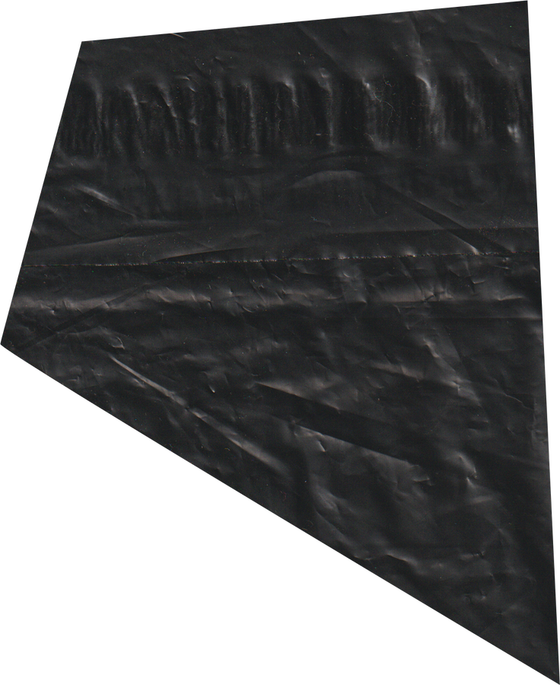


FINAL EXAM
AUTUM 2024
GROUP
DROPBOXUI
REPORT
GROUP 3

Slide 2


FINAL EXAM
INTRODUCTION
DropBox
STORAGE
DOWNLOAD
SHARE
GROUP 3

Slide 3
FINAL EXAM
TABLE OF CONTENT
1
ARCHITECTURE
3
NETWORKING
2
ACTIVITIES
4
OPTIMIZATION
5
DEMO
GROUP 3

Slide 4
FINAL EXAM
WINTER 2030
ARCHITECTURE
GROUP 3

Slide 5
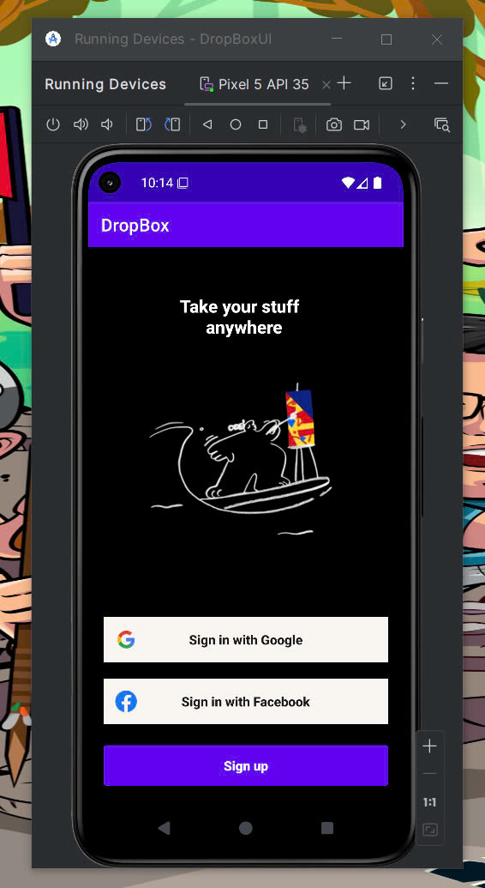
ARCHITECTURE
Login
GROUP 3

Slide 6


FINAL EXAM
ARCHITECTURE
main part
HOME
USERS
MY FILE
GROUP 3

Slide 7
FINAL EXAM
AUTUM 2024
ACTIVITIES
GROUP 3

Slide 8
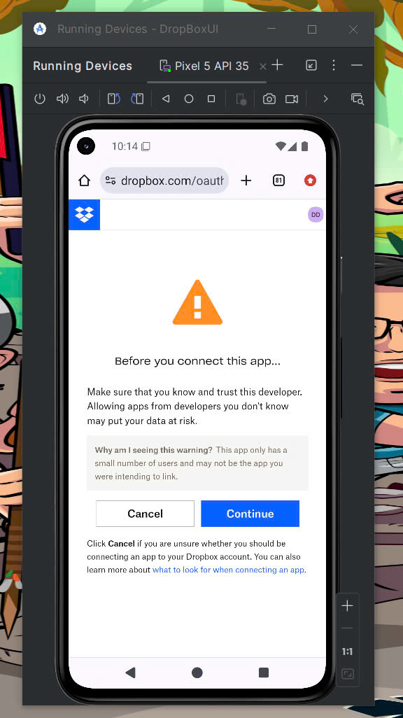
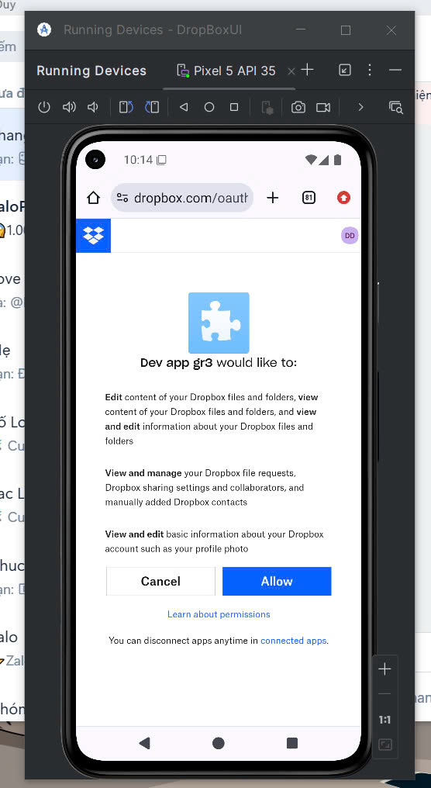
LOGIN
GROUP 3

Slide 9
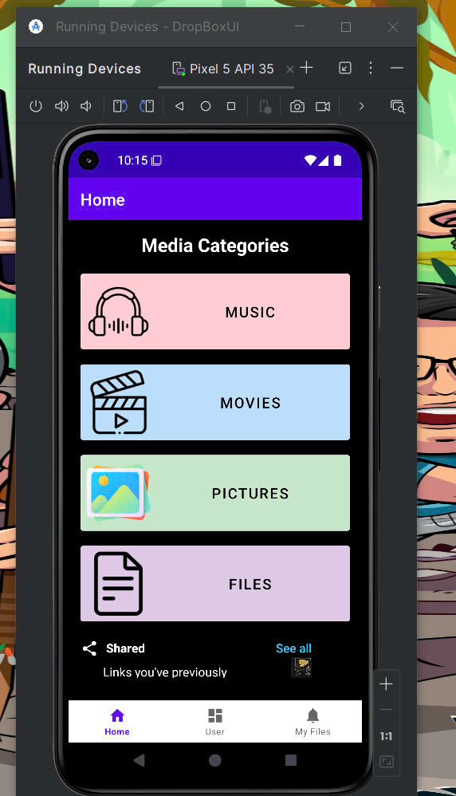
HOME
Music
Movies
pictures
files
GROUP 3

Slide 10
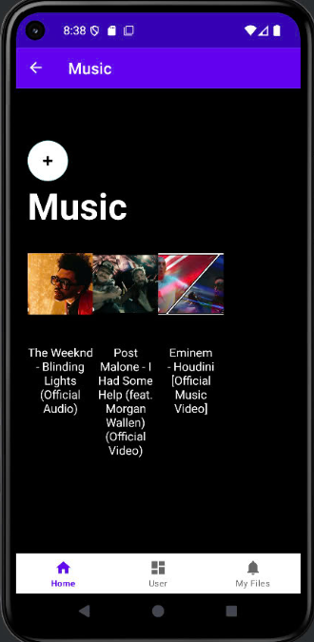
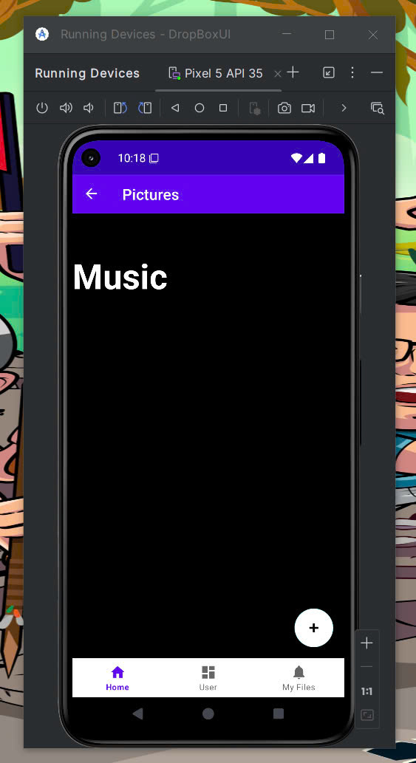
HOME
GROUP 3

Slide 11
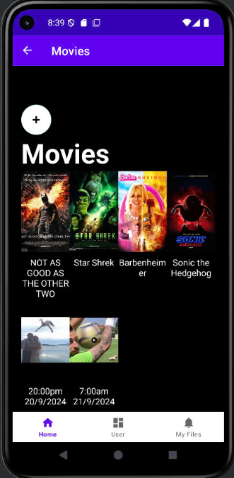
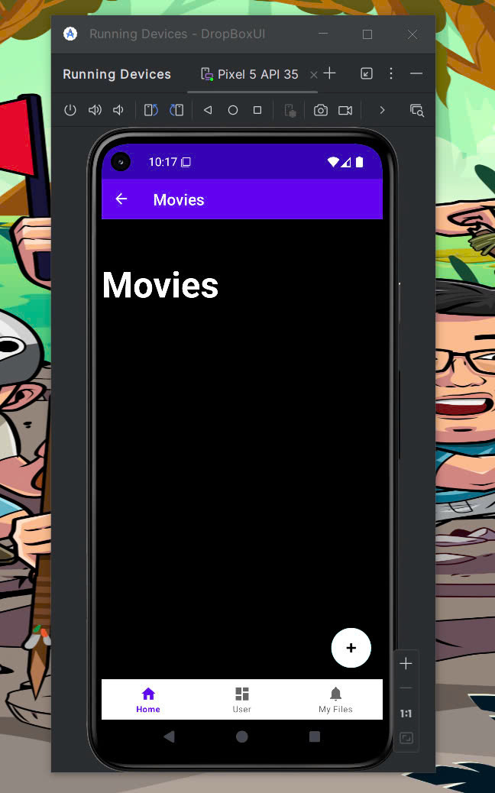
HOME
GROUP 3

Slide 12
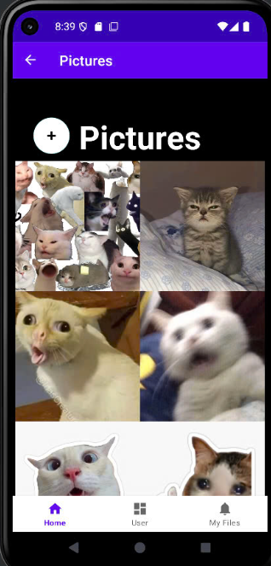
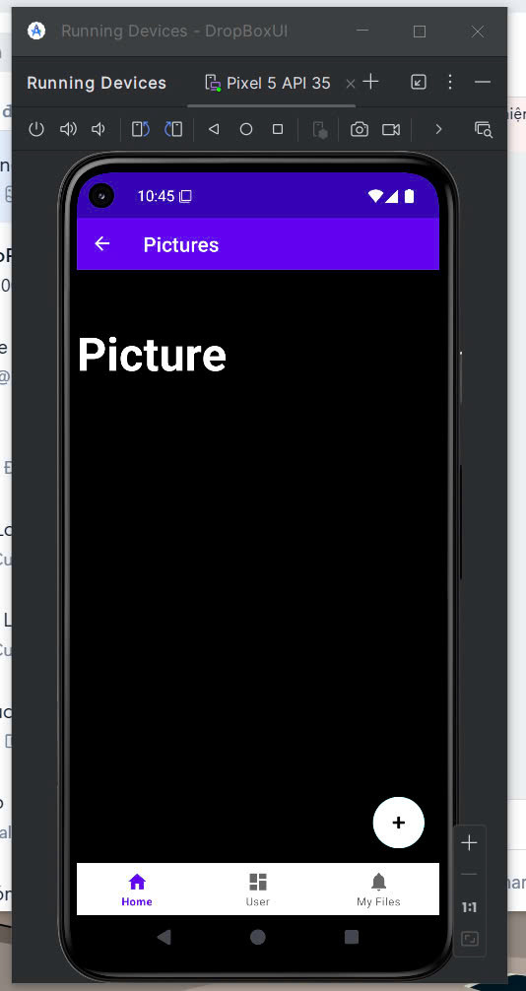
HOME
GROUP 3

Slide 13
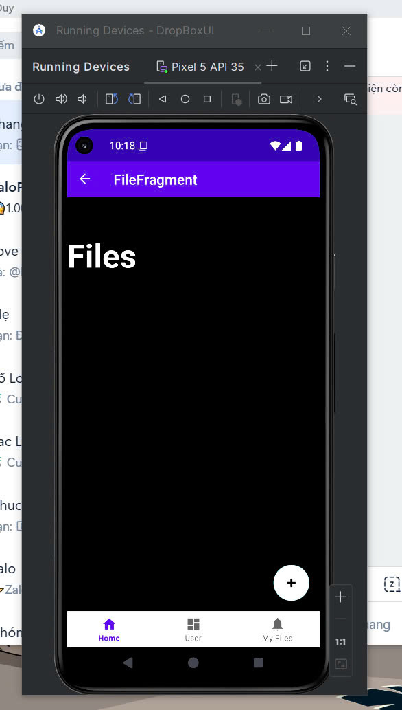
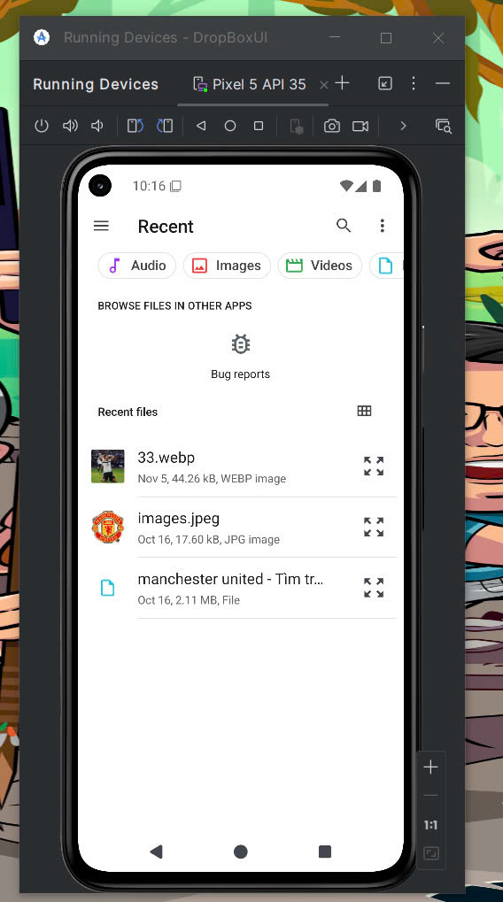
HOME
GROUP 3

Slide 14
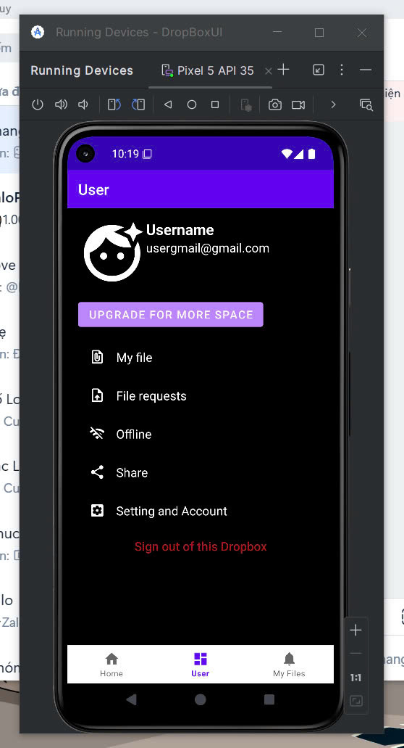
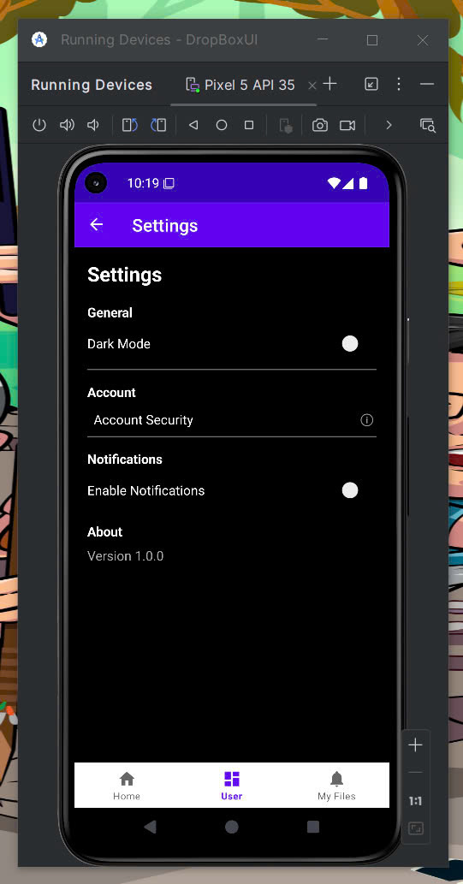
USER
GROUP 3

Slide 15
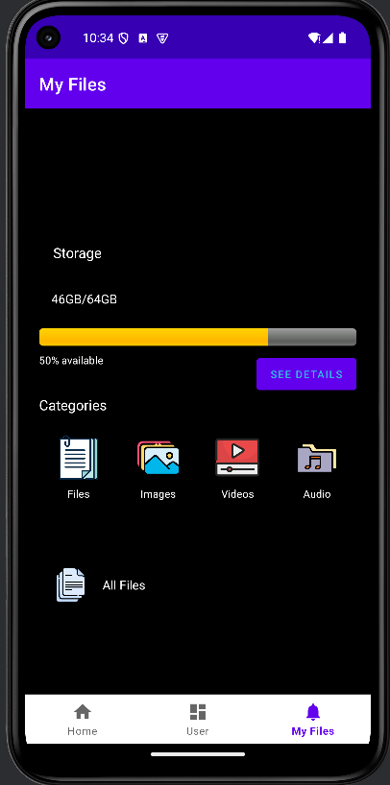
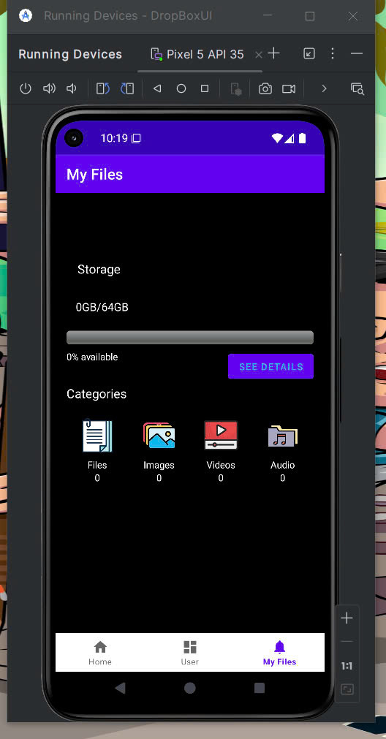
MY FILES
GROUP 3

Slide 16
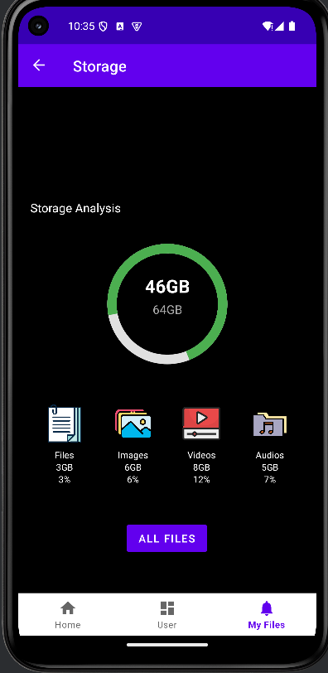
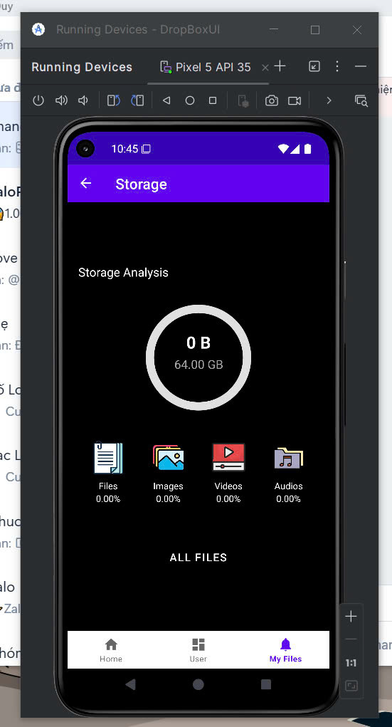
STORAGE
GROUP 3

Slide 17
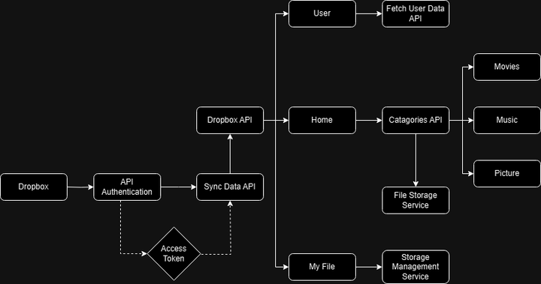
FINAL EXAM
GROUP 3

Slide 18
FINAL EXAM
AUTUM 2024
NETWORKING
GROUP 3

Slide 19
FINAL EXAM
AUTUM 2024
RETROFIT2
VOLLEY
GROUP 3

Slide 20
FINAL EXAM
AUTUM 2024
HTTPS://WWW.DROPBOX.COM/OAUTH2/AUTHORIZE
HTTPS://API.DROPBOX.COM/OAUTH2/TOKEN
HTTPS://API.DROPBOXAPI.COM/2/FILES/LIST_FOLDER
HTTPS://CONTENT.DROPBOXAPI.COM/2/FILES/UPLOAD
HTTPS://API.DROPBOXAPI.COM/2/USERS/GET_CURRENT_ACCOUNT
GROUP 3

Slide 21
FINAL EXAM
AUTUM 2024
OPTIMIZATION
GROUP 3

Slide 22
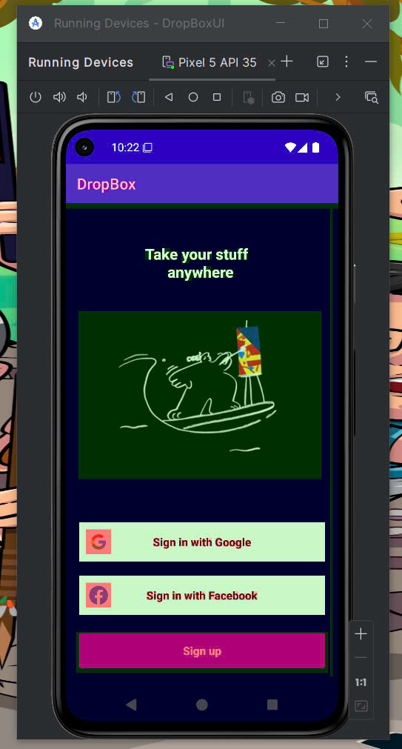
Normal
GPU Overdrawn enable
SIGN IN
GROUP 3

Slide 23
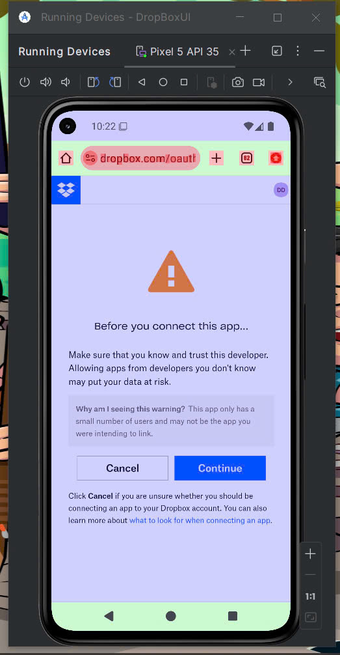
Normal
GPU Overdrawn enable
LOGIN
GROUP 3

Slide 24
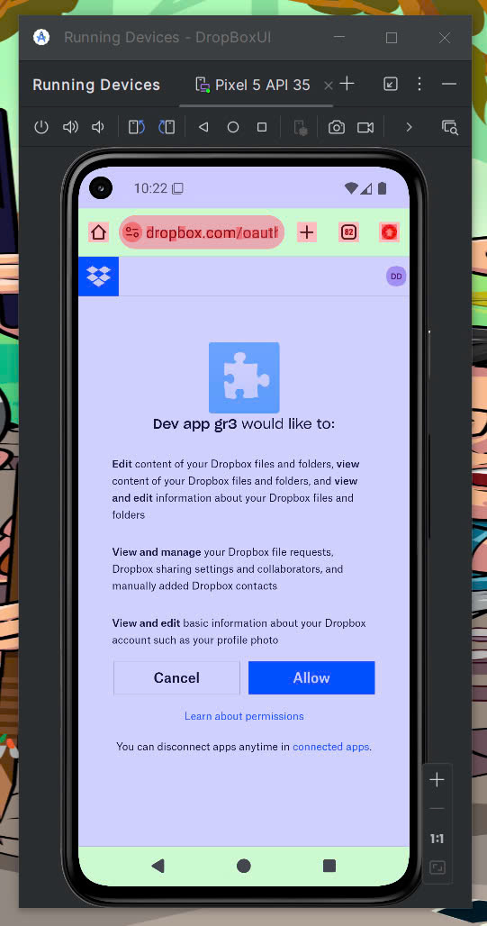
Normal
GPU Overdrawn enable
LOGIN
GROUP 3

Slide 25
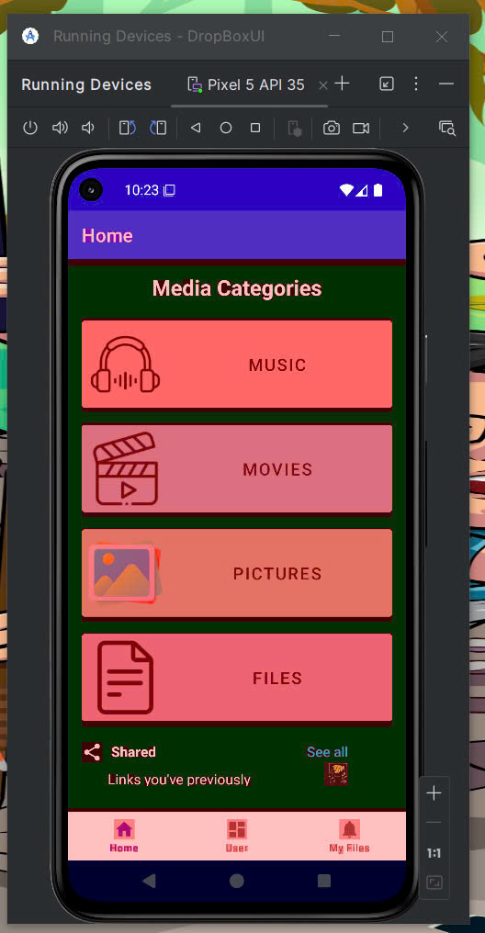
Normal
GPU Overdrawn enable
HOME
GROUP 3

Slide 26
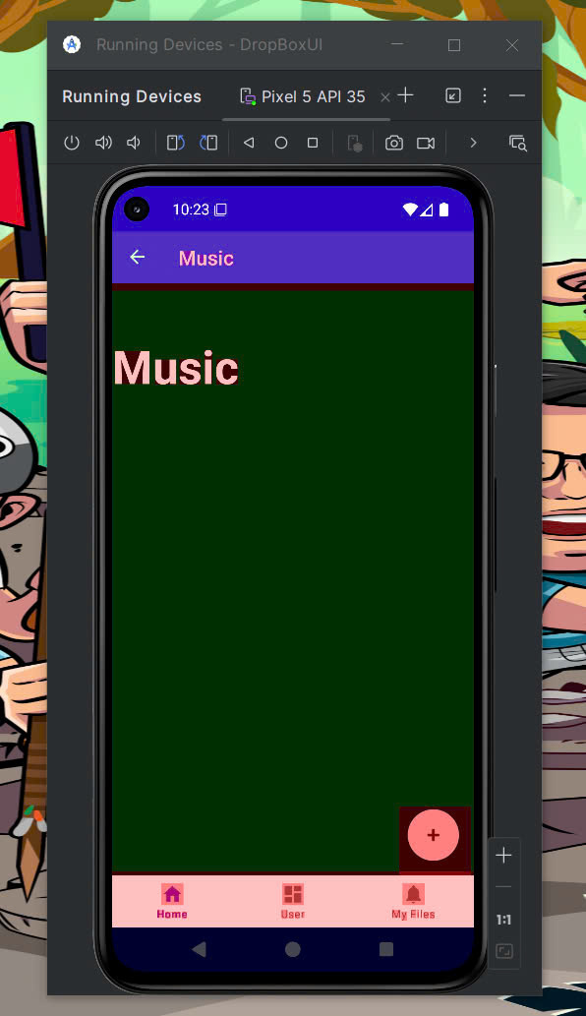
Normal
GPU Overdrawn enable
MUSIC
GROUP 3

Slide 27
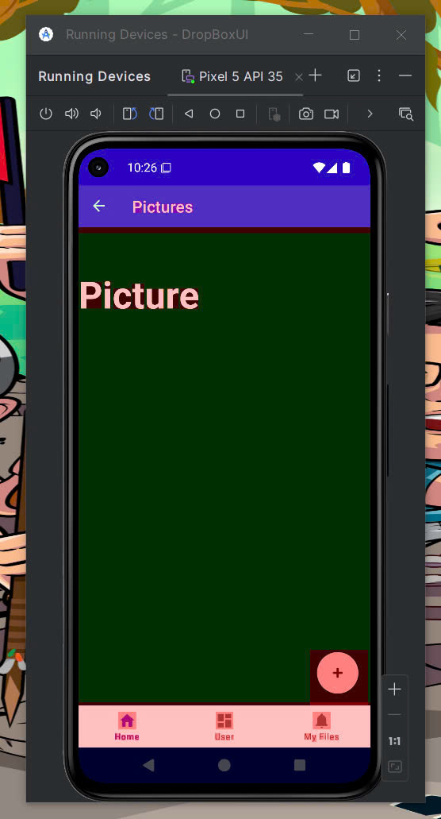
Normal
GPU Overdrawn enable
PICTURES
GROUP 3

Slide 28
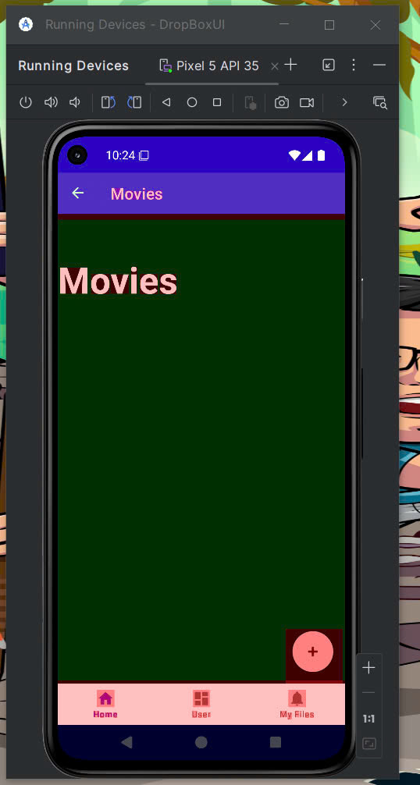
Normal
GPU Overdrawn enable
MOVIES
GROUP 3

Slide 29
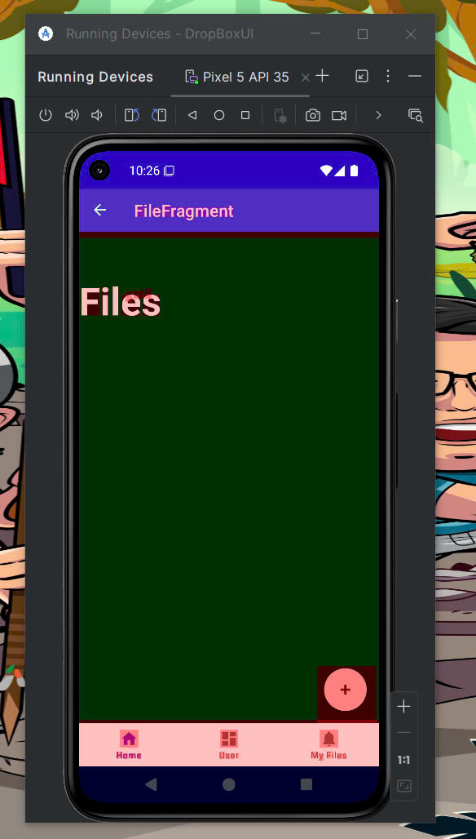
Normal
GPU Overdrawn enable
FILES
GROUP 3

Slide 30
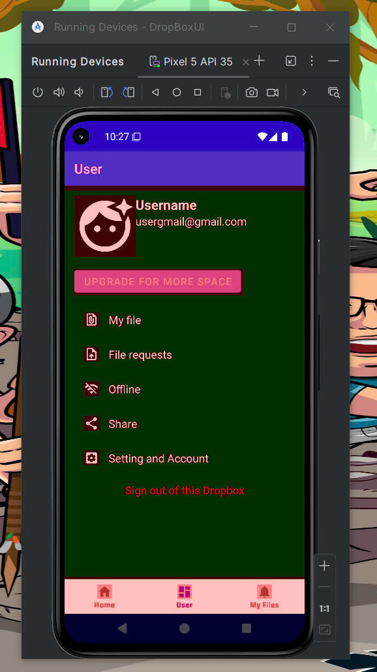
Normal
GPU Overdrawn enable
USER
GROUP 3

Slide 31
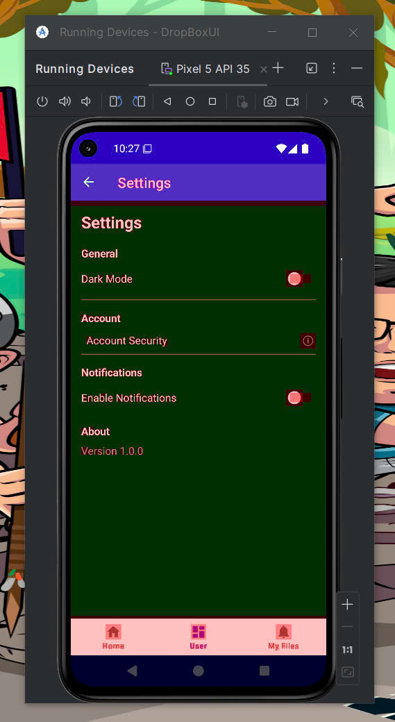
Normal
GPU Overdrawn enable
USER
GROUP 3

Slide 32
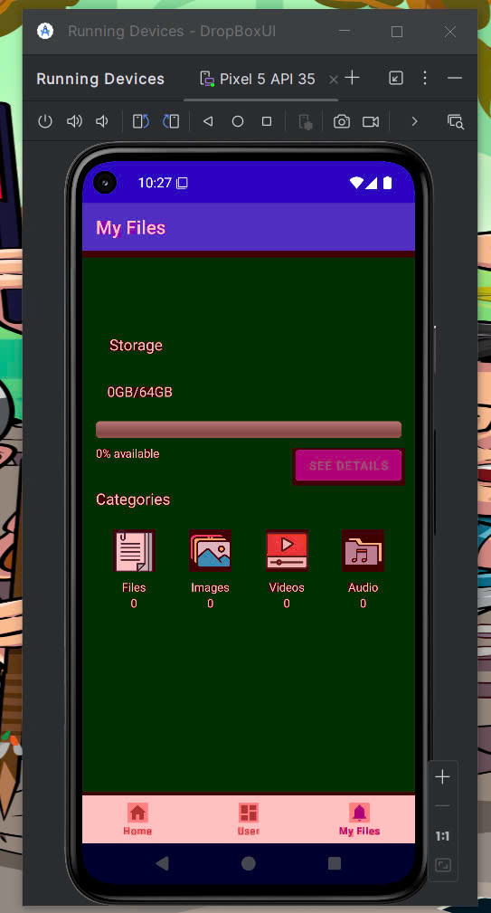
Normal
GPU Overdrawn enable
MY FILES
GROUP 3

Slide 33
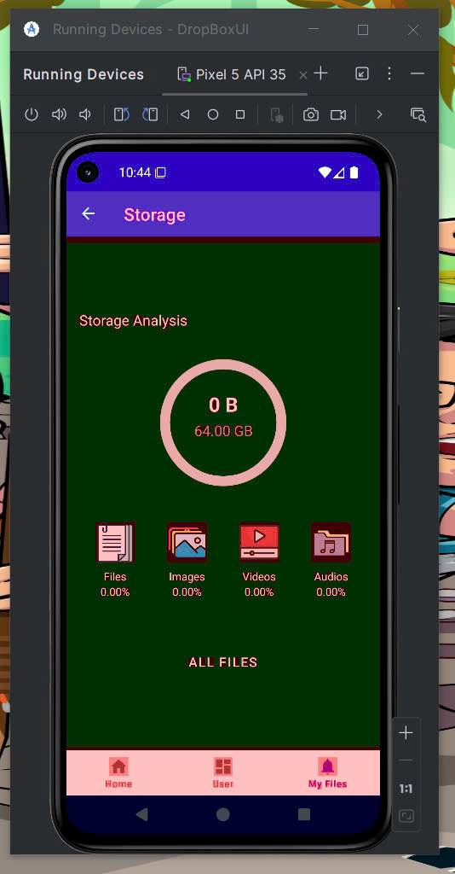
Normal
GPU Overdrawn enable
STORAGE
GROUP 3

Slide 34



@REALLYGREATSITE
CONCLUSION
FINISHED MOST OF THE APP
SOME SMALL FUNCTION ISN’T WORKING AT THE MOMENT
IMPROVE THE APP
GROUP 3

Slide 35
FINAL EXAM
WINTER 2030
DEMO
GROUP 3

Slide 36
FINAL EXAM
GROUP
1
DANG MINH DUY
2
NGO HAI ANH
3
NGUYEN PHUC KHANG
4
NGUYEN DUY HAI
5
LA DUY ANH
GROUP 3

Slide 37
FINAL EXAM
AUTUM 2024
THANK YOU
GROUP 3

